Slide 2
Example of Markov Chains
About 600 cities worldwide have bike share programs.
Typically a person pays a fee to join a the program and can borrow a bicycle from any bike share station and then can return it to the same or another system.
Each day, the distribution of bikes at the stations changes, as the bikes get returned to different stations from where they are borrowed.
For simplicity, let’s consider a very simple bike share program with only 3 stations: A, B, C.
Suppose that all bicycles must be returned to the station at the end of the day, so that each day there is a time, let’s say midnight, that all bikes are at some station, and we can examine all the stations at this time of day, every day.
We want to model the movement of bikes from midnight of a given day to midnight of the next day.
We find that over a 1 day period,
of the bikes borrowed from station A, 30% are returned to station A, 50% end up at station B, and 20% end up at station C.
of the bikes borrowed from station B, 10% end up at station A, 60% have been returned to station B, and 30% end up at station C
of the bikes borrowed from station C, 10% end up at station A, 10% end up at station B, and 80% are returned to station C.

Slide 3
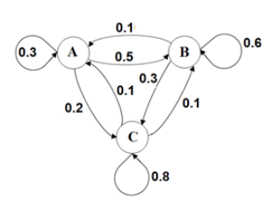
State Transition Diagram

Slide 4
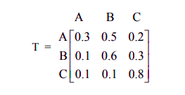
Transition Matrix
We can use a transition matrix to organize the information,
Each row in the matrix represents an initial state. Each column represents a terminal state.

Slide 5

State Vector
The transition matrix shows the probabilities for transitions between states at two consecutive times.
We need a way to represent the distribution among the states at a particular point in time.
To do this we use a row matrix called a state vector.
The state vector is a row matrix that has only one row; it has one column for each state.
The entries show the distribution by state at a given point in time. All entries are between 0 and 1 inclusive, and the sum of the entries is 1.
For the bike share example with 3 bike share stations, the state vector is a 1×3 matrix with 1 row and 3 columns.
Suppose that when we start observing our bike share program, 30% of the bikes are at station A, 45% of the bikes are at station B, and 25% are at station C. The initial state vector is

Slide 6
State Vector
The subscript 0 indicates that this is the initial distribution, before any transitions occur.
If we want to determine the distribution after one transition, we’ll need to find a new state vector that we’ll call V₁. The subscript 1 indicates this is the distribution after 1 transition has occurred.
We find V₁ by multiplying V₀ by the transition matrix T, as follows:

Slide 7
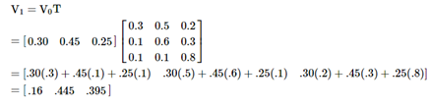
State Vector after one transition

Slide 8
State Vectors after 2nd transition
After 1 day (1 transition), 16 % of the bikes are at station A, 44.5 % are at station B and 39.5% are at station C.
Suppose now that we want to know the distribution of bicycles at the stations after two days.
We need to find V₂, the state vector after two transitions.
To find V₂ , we multiply the state vector after one transition V₁ by the transition matrix T.

Slide 9
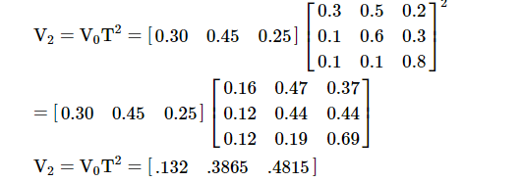

State Vector as a power of Transition Matrix

Slide 10
State Vector after n transitions
After 2 days (2 transitions), 13.2 % of the bikes are at station A, 38.65 % are at station B and 48.15% are at station C.
Similarly, if we raise transition matrix T to the nth power, the entries in T^{n} tells us the probability of a bike being at a particular station after n transitions, given its initial station.
And if we multiply the initial state vector V₀ by T^{n}, the resulting row matrix V_{n}=V₀T^{n} is the distribution of bicycles after n transitions.

Slide 11
Applications of Markov Chains
Markov chains have been proposed to model locations of cars distributed among multiple car rental locations for a car rental company, and locations of cars in car share programs.
Markov chains models analyze package delivery schedules when packages are transported between several intermediate transport and storage locations on their way to their final destination.
In these situations, Markov chains are often one part of larger mathematical models using a combination of other techniques, such as optimization to maximize profit or revenue or minimize cost using linear programming.
Markov chains can be similarly used in market research studies for many types of products and services, to model brand loyalty and brand transitions.
In the field of finance, Markov chains can model investment return and risk for various types of investments.
Markov chains can model the probabilities of claims for insurance, such as life insurance and disability insurance, and for pensions and annuities.
For example, for disability insurance, a much simplified model might include states of healthy, temporarily disabled, permanently disabled, recovered, and deceased;

Slide 12
Applications of Markov Chains
Markov chains have been used in the fields of public health and medicine.
Markov chains models of HIV and AIDS include states to model HIV transmission, progression to AIDs, and survival (living with HIV or AIDS) versus death due to AIDS.
Markov chains are used in ranking of websites in web searches.
Markov chains model the probabilities of linking to a list of sites from other sites on that list; a link represents a transition.
The Markov chain is analyzed to determine if there is a steady state distribution, or equilibrium, after many transitions.
Once equilibrium is identified, the pages with the probabilities in the equilibrium distribution determine the ranking of the web pages.
This is a very simplified description of how Google uses Markov chains and matrices to determine “Page rankings” as part of their search algorithms.
Of course, a real world use of such a model by Google would involve immense matrices with thousands of rows and columns. The size of such matrices

Slide 13
Markov Chains Applications
Markov chains are also used in quality analysis of cell phone and other communications transmissions.
Transition matrices model the probabilities of certain types of signals being transmitted in sequence.
Certain sequences of signals are more common and expected, having higher probabilities; on the other hand, other sequences of signals are rare and have low probabilities of occurrence.
If certain sequences of signals that are unlikely to occur actually do occur, that might be an indication of errors in transmissions; Markov chains help identify the sequences that represent likely transmission errors.

Slide 14
Regular Markov Chains
As we calculate higher and higher powers of T in the bike sharing example, the matrix starts to stabilize, and finally it reaches its steady-state or state of equilibrium.
When that happens, all the row vectors became the same, and we call one such row vector a fixed probability vector or an equilibrium vector E.
Furthermore, we discover that ET = E.
Some Markov chains reach a state of equilibrium but some do not.
Some Markov chains transitions do not settle down to a fixed or equilibrium pattern.

Slide 15
Recognizing Markov Chains
We’d like to have a way to identify Markov chains that do reach a state of equilibrium.
A Markov chain is said to be a regular Markov chain if some power of its transition matrix T has only positive entries.
To determine if a Markov chain is regular, we examine its transition matrix T and powers, T^{n}, of the transition matrix.
If we find any power n for which T^{n} has only positive entries (no zero entries), then we know the Markov chain is regular and is guaranteed to reach a state of equilibrium in the long run.

Slide 16
Identifying Regular Markov Chains
Fortunately, we don’t have to examine too many powers of the transition matrix T to determine if a Markov chain is regular.
There is a theorem that says that if an n×n transition matrix represents n states, then we need only examine powers T^{m} up to m=(n−1)2+1 .
If some power of the transition matrix T^{m} is going to have only positive entries, then that will occur for some power m≤(n−1)2+1 .
For example, if T is a 3×3 transition matrix, then
m=(n−1)2+1=(3−1)2+1=5.
If we examine T, T², T³, T⁴ and T⁵, and find that any of those matrices has only positive entries, then we know T is regular.
If however, T, T², T³, T⁴ and T⁵, all have at least one zero entry and none of them have all positive entries, then we can stop checking. All higher powers of T will also have at least one zero entry, and T will not be regular.

Slide 17
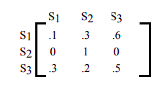
Absorbing Markov Chain
In certain types of Markov chain in which when a certain state is reached, it is impossible to leave that state.
Such states are called absorbing states, and a Markov Chain that has at least one such state is called an Absorbing Markov chain.
Suppose you have the following transition matrix.

Slide 18
Absorbing Markov Chain
The state S₂ is an absorbing state, because the probability of moving from state S₂ to state S₂ is 1. Which is another way of saying that if you are in state S₂, you will remain in state S₂.
In fact, this is the way to identify an absorbing state. If the probability in row ii and column ii, piipii, is 1, then state S_{i} is an absorbing state.

Slide 19
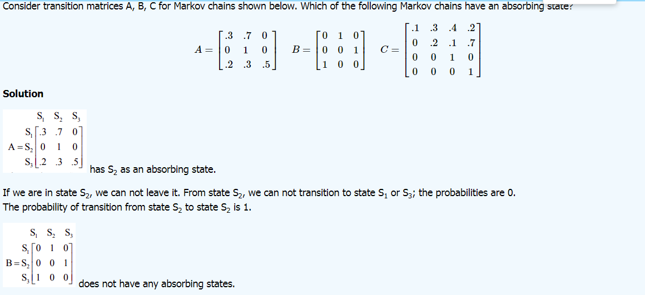
Absorbing Markov Chain

Slide 20
Identifying absorbing state
A state S is an absorbing state in a Markov chain in the transition matrix if the row for state S has one 1 and all other entries are 0
AND
The entry that is 1 is on the main diagonal (row = column for that entry), indicating that we can never leave that state once it is entered.

Slide 21
fter 2 days (2 transitions), 13.2 % of the bikes are at station A, 38.65 % are at station B and 48.15% are at station C.
We need to examine the following: What is the meaning of the entries in the matrix T²?
Similarly, if we raise transition matrix T to the nth power, the entries in T^{n} tells us the probability of a bike being at a particular station after n transitions, given its initial station.
And if we multiply the initial state vector V₀ by T^{n}, the resulting row matrix Vn=V₀T^{n} is the distribution of bicycles after nn transitions.

Slide 22
Solution Matrix
We can write a “solution matrix” by retaining only rows that relate to the non-absorbing states and retaining only the columns that relate to the absorbing states.

Slide 23
Gambler’s Ruin Problem
A gambler has $3,000, and she decides to gamble $1,000 at a time at a Black Jack table in a casino in Las Vegas. She has told herself that she will continue playing until she goes broke or has $5,000. Her probability of winning at Black Jack is .40. Write the transition matrix, identify the absorbing states, find the solution matrix, and determine the probability that the gambler will be financially ruined at a stage when she has $2,000.

Slide 24
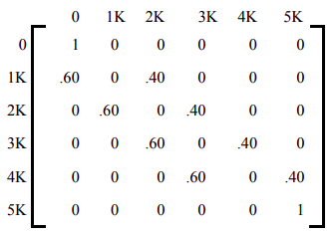
Gambler’s ruin problem
The transition matrix is written below.
Clearly the state 0 and state 5K are the absorbing states.
As soon as the gambler reaches 0, she is financially ruined and the game is over.
Similarly, if the gambler reaches $5,000, she has promised herself to quit and, again, the game is over.
The reader should note that p₀₀ = 1, and p₅₅ = 1.

Slide 25
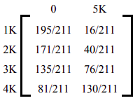
Gambler Ruin’s Problem
To determine the long term trend, we raise the matrix to higher powers until we get the solution matrix.
The solution matrix is often written in the following form, where the non-absorbing states are written as rows on the side, and the absorbing states as columns on the top.

Slide 26
Gambler Ruin’s Problem
The table lists the probabilities of getting absorbed in state 0 or state 5K starting from any of the four non-absorbing states.
For example, if at any instance the gambler has $3,000, then her probability of financial ruin is 135/211 and her probability reaching 5K is 76/211.

Slide 27
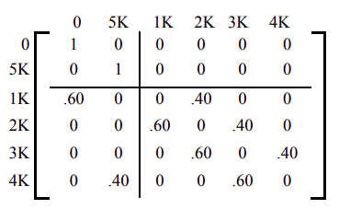
In solving absorbing states, it is often convenient to rearrange the matrix so that the rows and columns corresponding to the absorbing states are listed first. This is called the Canonical form.

Slide 28

Canonical Form of Transition Matrix
The canonical form divides the transition matrix into four sub-matrices as listed below.

Slide 29
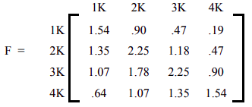
Fundamental Matrix
The matrix F=(I_{n}−B)−1 is called the fundamental matrix for the absorbing Markov chain, where I_{n} is an identity matrix of the same size as B.
The i , j -th entry of this matrix tells us the average number of times the process is in the non-absorbing state j before absorption if it started in the non-absorbing state i .
The matrix F=(In−B)−1 for our problem is listed below.

Slide 30
Gambler Ruin’s Problem
The Fundamental matrix F helps us determine the average number of games played before absorption.
According to the matrix, the entry 1.78 in the row 3, column 2 position says that the gambler will play the game 1.78 times before she goes from $3K to $2K. The entry 2.25 in row 3, column 3 says that if the gambler now has $3K, she will have $3K on the average 2.25 times before the game is over.
We now address the question of how many bets will she have to make before she is absorbed, if the gambler begins with $3K?
If we add the number of games the gambler plays in each non-absorbing state, we get the average number of games before absorption from that state.
Therefore, if the gambler starts with $3K, the average number of Black Jack games she will play before absorption is
1.07+1.78+2.25+0.90=6.0
That is, we expect the gambler will either have $5,000 or nothing on the 7th bet.

Slide 31
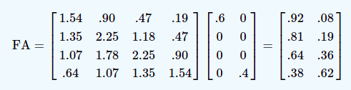
Solution Matrix for Gambler’s Problem
We find the solution matrix without raising the transition matrix to higher powers. The matrix FA gives us the solution matrix.

Slide 32
Gambler Ruin’s Problem
A persistent gambler with finite wealth, playing a fair game (that is, each bet has expected value zero to both sides) will eventually and inevitably go broke against an opponent with infinite wealth.
Such a situation can be modeled by a random walk on the real number line. In that context it is provable that the agent will, with virtual certainty, return to his point of origin, which means going broke, and is ruined an infinite number of times if the random walk continues forever.

